Slide 1
EZTechMovie StreamList Project Timeline and User Interface Design
Stephen Foster, Jose Hernandez, Jaylyn Johnson
The University of Arizona Global Campus
INT499: Capstone for Information Technology
Professor Amine Dehmani
August 17, 2026
https://github.com/bestchallenge14/INT499-Group-A

Slide 2




Project Tasks, Dependencies, and Estimations

Slide 3
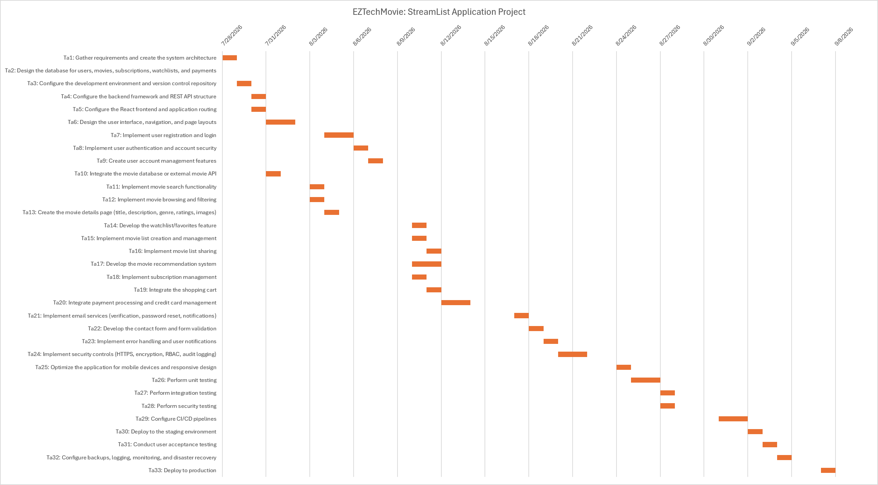
Gantt Chart

Slide 4

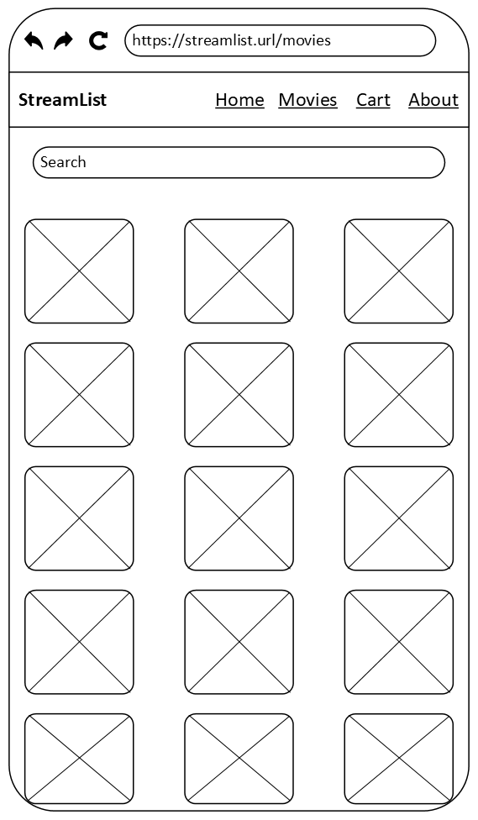
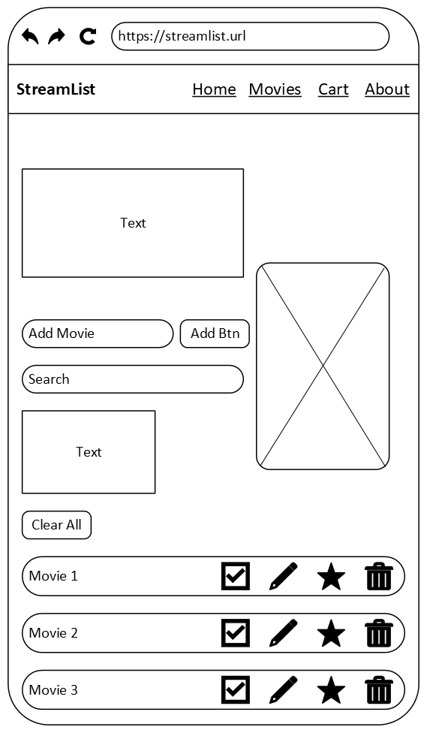

StreamList Lo-Fidelity Design

Slide 5
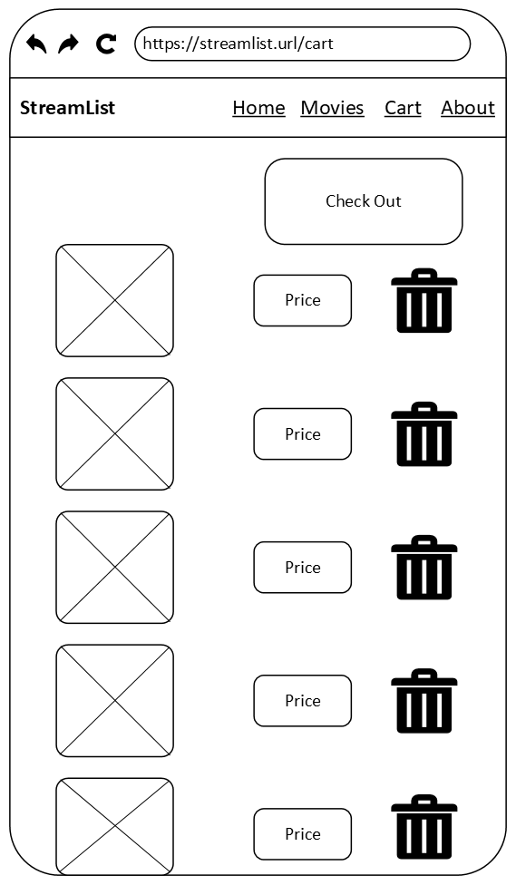
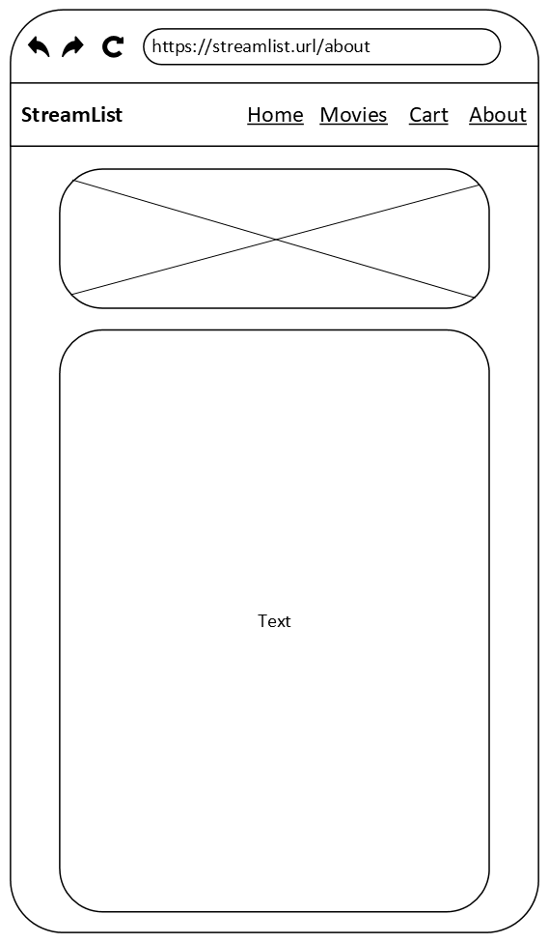
StreamList Lo-Fidelity Design (Cont.)

